Slide 1
Introduction to Embedded System Design using Zynq
Zynq
Vivado 2015.2 Version

Slide 2
Outline
The Zynq Architecture
Embedded System Development with Vivado

Slide 3
Introducing Zynq
Xilinx’s new generation of All-Programmable System-on-Chip (SoC)
a (processing) element that can be applied to anything.
Zynq devices are intended to be flexible and form a compelling platform for a wide variety of applications, just as the metal zinc can be mixed with various other metals to form alloys with differing desirable properties.

Slide 4
Definition of Zynq
It combines a dual-core ARM Cortex-A9 processor with traditional FPGA.
The ARM Cortex-A9 is an application grade processor, capable of running full operating systems such as Linux.
The programmable logic is based on Xilinx 7-series FPGA architecture, which is completed by industry standard AXI interfaces, which provide high bandwidth, low latency connections between the two parts of the device.
The processor and logic can each be used for what they do best, without the overhead of interfacing between two physically separate devices.
Benefits arising from simplifying the system to a single chip include reductions in physical size and overall cost.
Notes:
In Zynq, the ARM Cortex-A9 is an application grade processor, capable
of running full operating systems such as Linux, while the programmable logic is based on
Xilinx 7-series FPGA architecture [5], [7]. The architecture is completed by industry
standard AXI interfaces, which provide high bandwidth, low latency connections between
the two parts of the device [8]. This means that the processor and logic can each be used for
what they do best, without the overhead of interfacing between two physically separate
devices. Meanwhile, benefits arising from simplifying the system to a single chip include
reductions in physical size and overall cost.
- Ebook page 1.

Slide 5
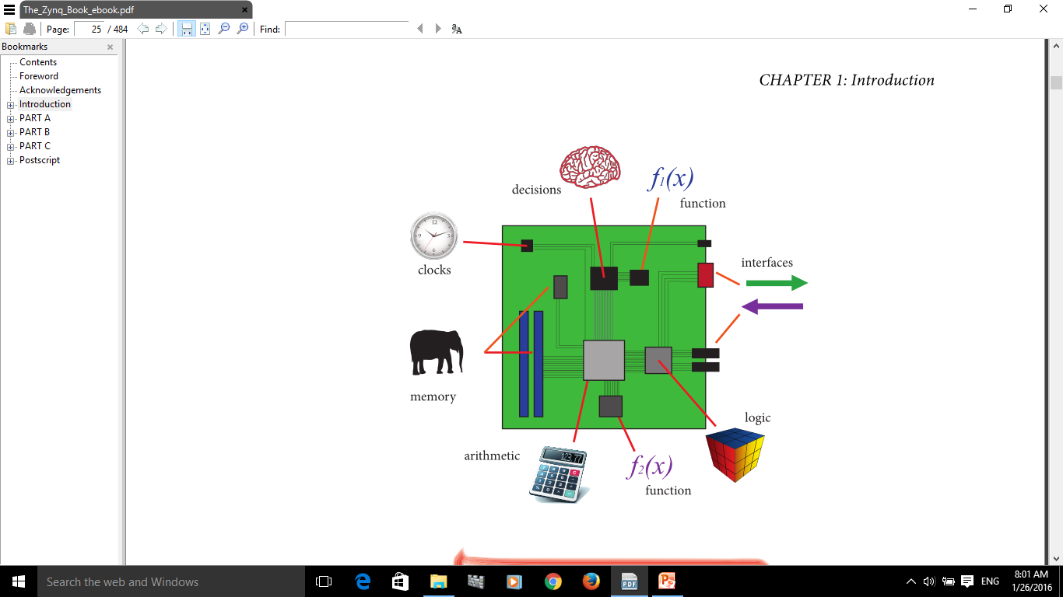
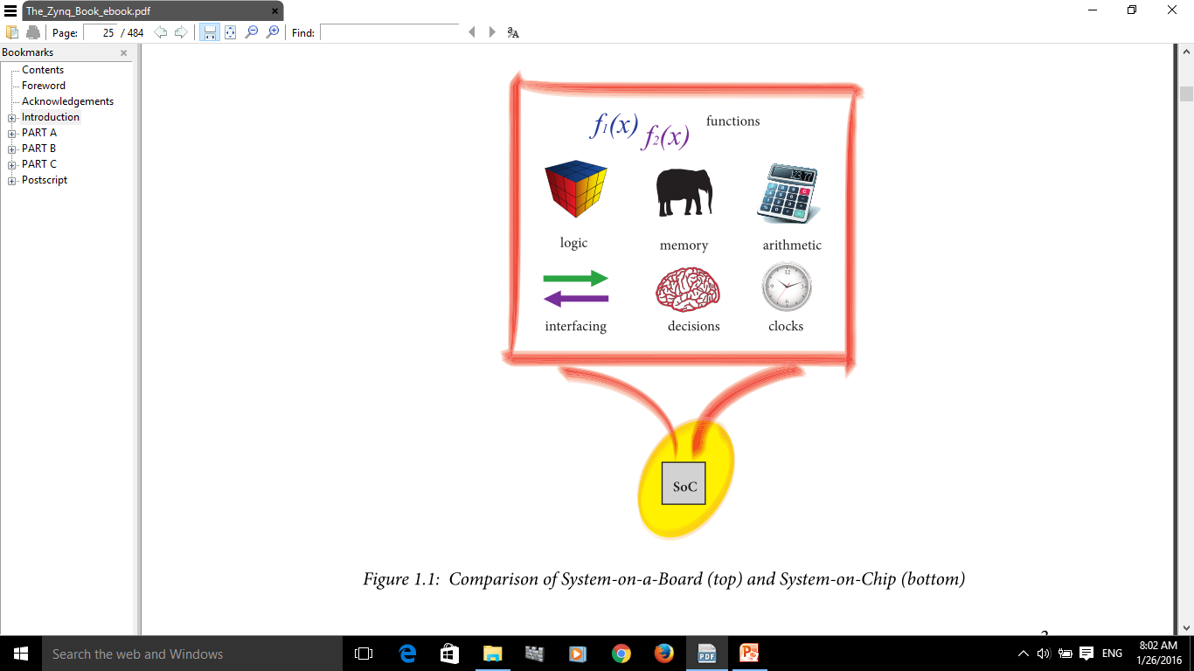
Comparison of System-on-a-Board and System-on-Chip
SoC is lower cost, enables faster and more secure data transfers between the various system elements, has higher overall system speed, lower power consumption, smaller physical size, and better reliability.
Notes:
The SoC solution is lower cost, enables faster and more secure data transfers between the various system elements,
has higher overall system speed, lower power consumption, smaller physical size, and better reliability.
ASIC-based SoCs are suitable only for high-volume markets where there is no requirement for future upgrades. Representative examples of ASIC-based SoCs are
the integrated processors found in PCs, tablets, and smartphones; these typically comprise at least two processor cores, memory, graphics, interfacing, and other functions and are manufactured in high volume for products with a limited lifetime.

Slide 6
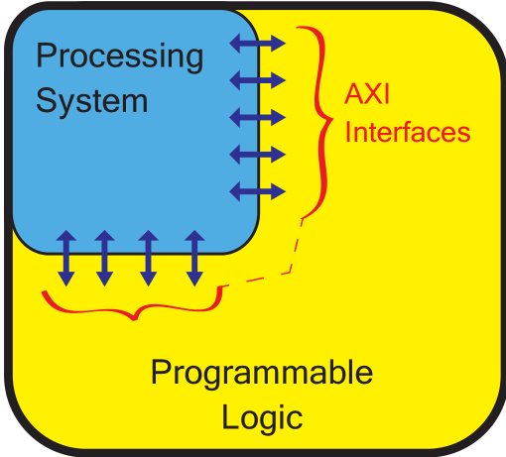
A simplified model of the Zynq architecture – an ‘All-Programmable SoC’ (APSoC)
Links between the PL and PS.
Comprises two main parts:
A Processing System (PS) formed around a dual-core ARM Cortex-A9 processor, and
Programmable Logic (PL), which is equivalent to that of an FPGA.
The overall functionality can be appropriately partitioned between hardware and software:
PL: implementing high-speed logic, arithmetic and data flow subsystems,
PS: supports software routines and/or operating systems
Notes:
Zynq
comprises two main parts: a Processing System (PS) formed around a dual-core ARM
Cortex-A9 processor, and Programmable Logic (PL), which is equivalent to that of an
FPGA. It also features integrated memory, a variety of peripherals, and high-speed
communications interfaces.
The PL section is ideal for implementing high-speed logic, arithmetic and data flow
subsystems, while the PS supports software routines and/or operating systems, meaning
that the overall functionality of any designed system can be appropriately partitioned
between hardware and software. Links between the PL and PS are made using industry standard Advanced eXtensible Interface (AXI) connections [8]. Further details of each of
these features will be presented as the book progresses.
The PL section is ideal for implementing high-speed logic, arithmetic and data flow
subsystems, while the PS supports software routines and/or operating systems, meaning
that the overall functionality of any designed system can be appropriately partitioned
between hardware and software. Links between the PL and PS are made using industry standard Advanced eXtensible Interface (AXI) connections.
- Ebook Page 4

Slide 7
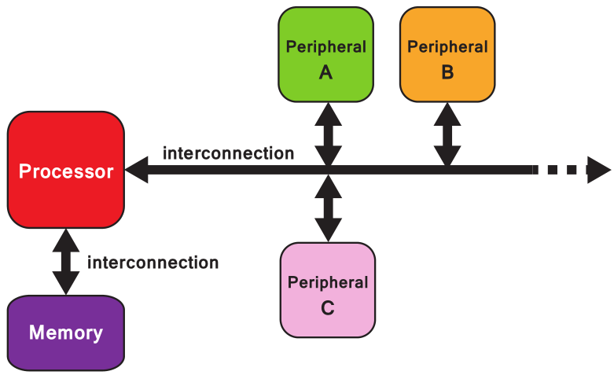
The hardware system architecture of an embedded SoC (simplified)
Communication between system elements takes place via interconnections in the style of
direct,
point-to-point links, or
buses serving multiple
components.
Peripherals:
Functional components residing away from the processor
coprocessors
cores for interacting with external interfaces,
Additional memory elements.

Slide 8
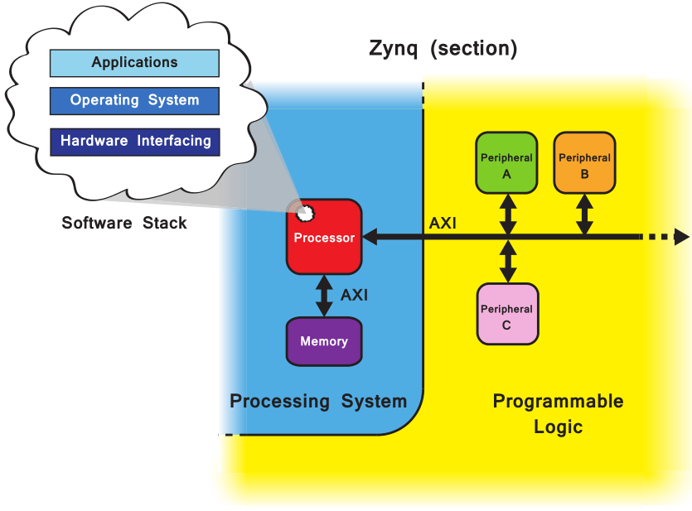
Relationship of the software system & hardware system in Zynq architecture
The PS has a fixed architecture and hosts the processor and system memory,
PL is completely flexible, giving the designer a ‘blank canvas’ to create custom peripherals, or to reuse standard ones.
Notes:
Peripherals are functional components residing away from the processor, and in general
these perform one of three functions: (i) coprocessors — elements that supplement the
primary processor, usually optimised for a certain task; (ii) cores for interacting with
external interfaces, e.g. connecting to LEDs and switches, codecs, etc.; and (iii) additional
memory elements.

Slide 9
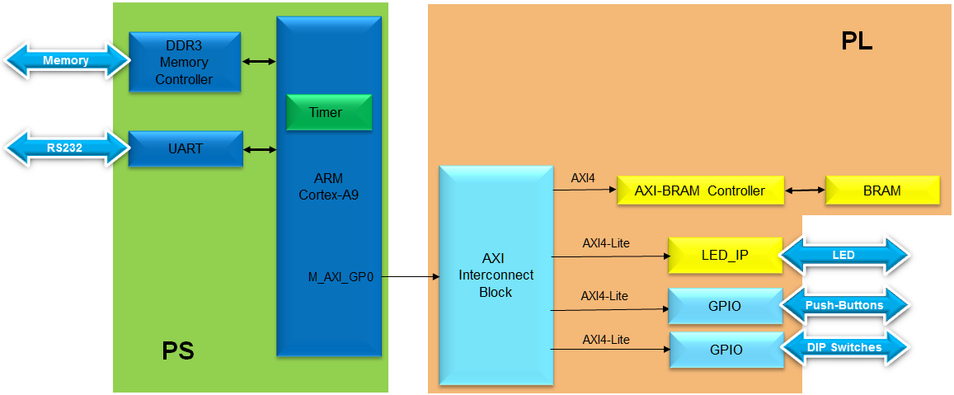
Embedded Design Architecture in Zynq
Embedded design with Zynq is based on:
Processor and peripherals
Dual ARM® Cortex™ -A9 processors of Zynq-7000 AP SoC
AXI interconnect
AXI component peripherals
Reset, clocking, debug ports
Software platform for processing system
Bare Metal Applications or OS’s (e.g. Linux, FreeRTOS)
C language support
Processor services
C drivers for hardware
User application
Interrupt service routines (optional)
Step 1: Create a project using Vivado
Step 2: Create Processor System using IP Integrator
Step 3: Generate Top-Level HDL and Export to SDK
Step 4:
Create a Software Application in SDK
Step 5:
Verify Functionality in Hardware

Slide 10
Vivado
What are Vivado, IP Integrator and SDK?
Vivado is the tool suite for Xilinx FPGA design and includes capability for embedded system design
IP Integrator, is part of Vivado and allows system level design of the hardware part of an Embedded system
Integrated into Vivado
Vivado includes all the tools, IP, and documentation that are required for designing systems with the Zynq-7000 AP SoC hard core and/or Xilinx MicroBlaze soft core processor
Vivado + IPI replaces ISE/EDK
SDK is an Eclipse-based software design environment
Enables the integration of hardware and software components
Links from Vivado
Vivado is the overall project manager and is used for developing non-embedded hardware and instantiating embedded systems
Vivado/IP Integrator flow is recommended for developing Zynq embedded systems

Slide 11
Vivado Components
Vivado/IP Integrator
Design environment for configuration of PS, and hardware design for PL
Hardware Platform (xml)
Platform, software, and peripheral simulation
Vivado logic analyzer integration
Software Development Kit (SDK)
Project workspace
Hardware platform definition
Board Support Package (BSP)
Software application
Software debugging
Hardware Design
HW/SW Simulation
Software Design
HW/SW Debug

Slide 12
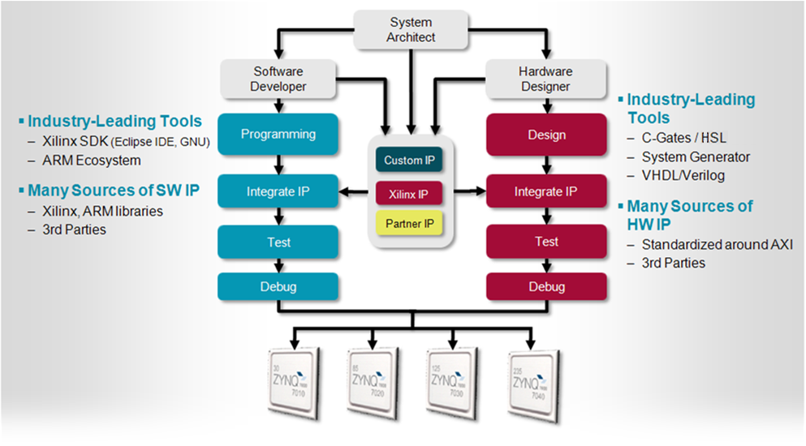
Embedded System Design Flow for Zynq-7000 AP SoC

Slide 13
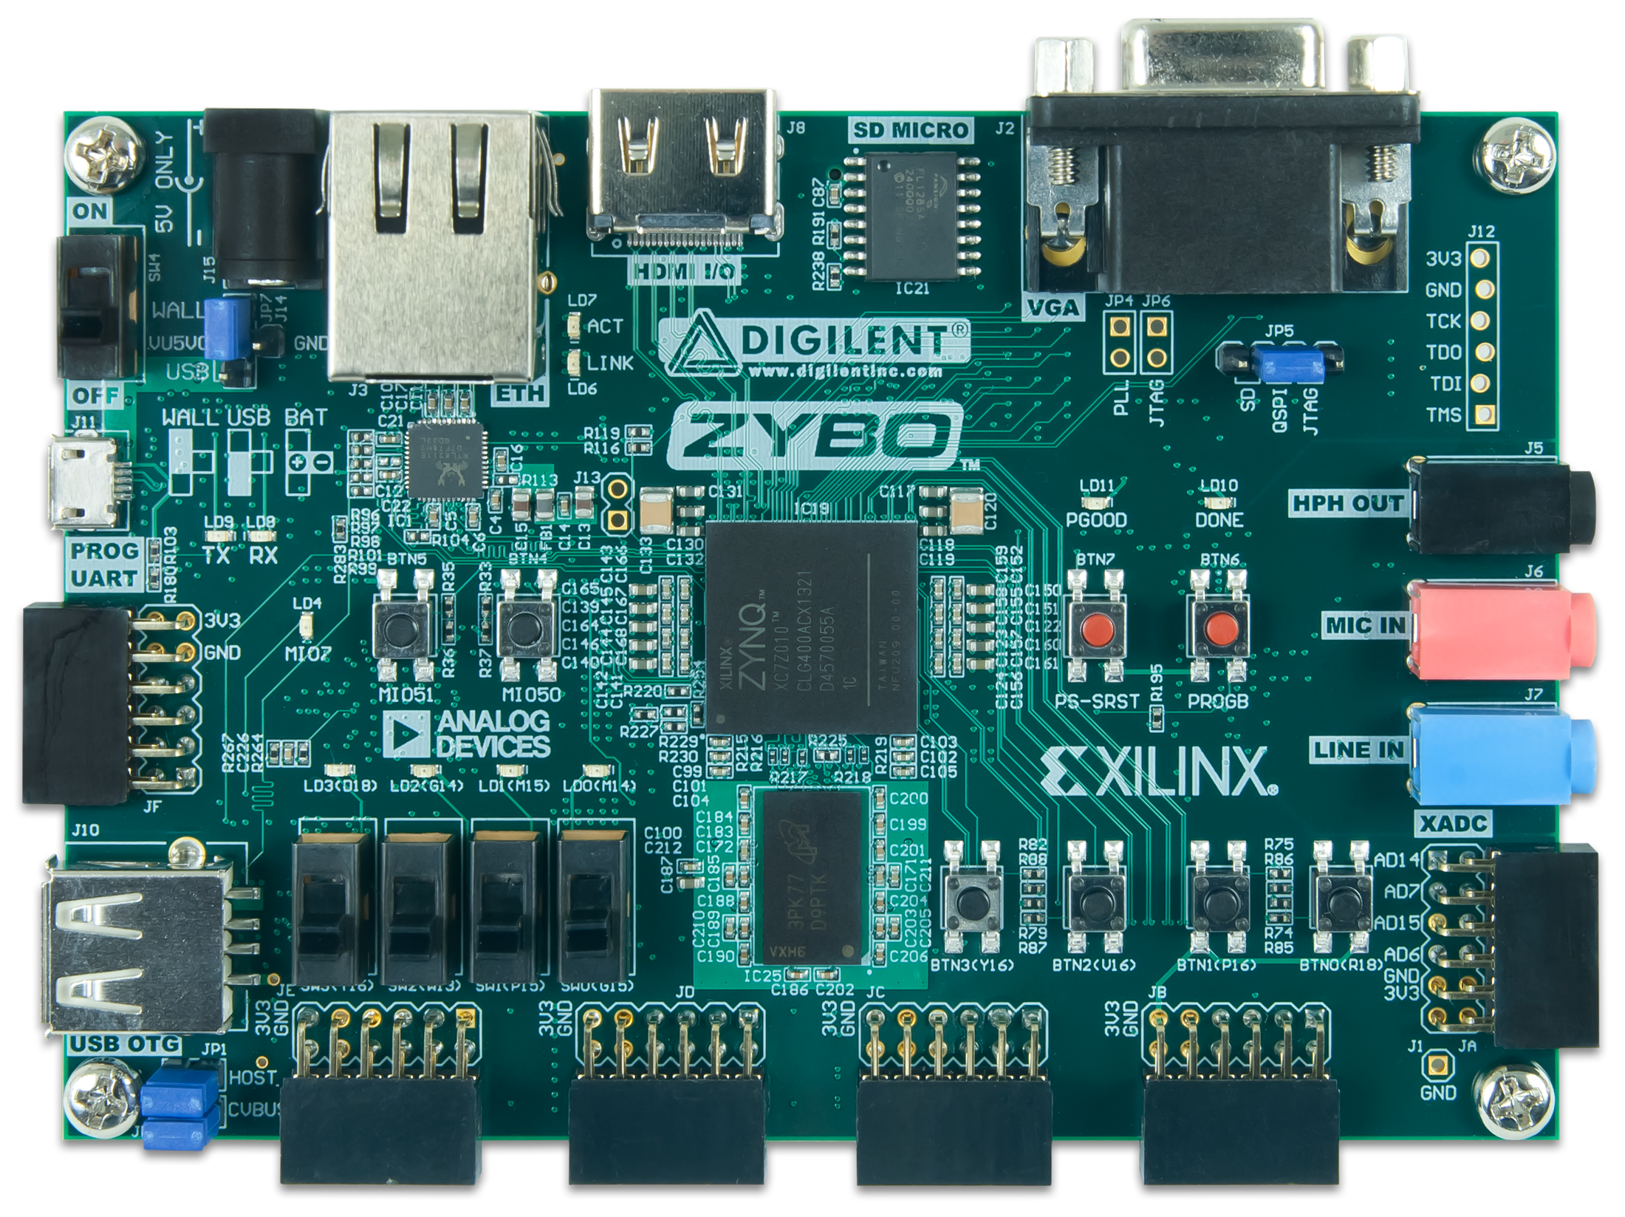
Embedded System Design using Vivado
1. Launch Vivado
2. Invoke IP Integrator to create Block Diagram
5. Generate Top-Level HDL
6. Add Constraints
7. Generate Bitstream => .bit
8. Export hardware to SDK
3. Configure PS settings
4. Add IP & configure
9. Specify hardware description from Vivado
10. Add Software Project & Build => .elf
Hardware Configuration
IP Integrator
Vivado
SDK
11. Program bitstream & .elf into Zynq
ZYBO

Slide 14
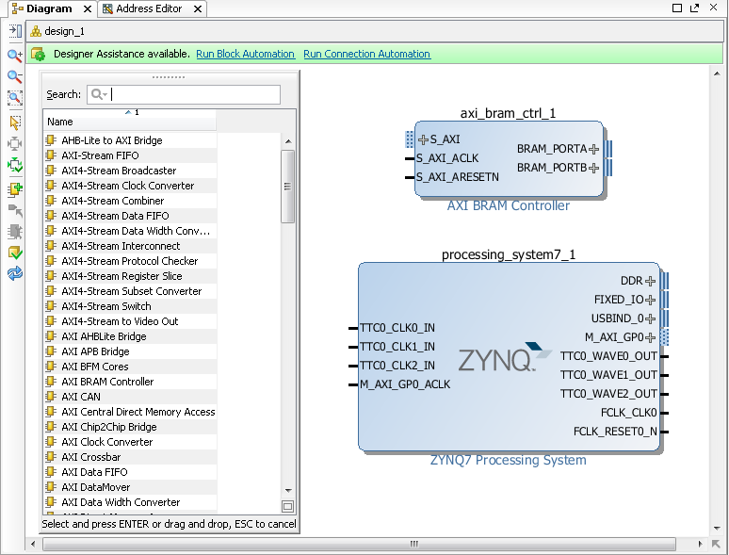
Integrator Block Diagram
IP Integrator Block Diagram opens a blank canvas
IP can be added from the IP catalog
Drag and drop interface
Intelligent Design environment
Design Assistance
Connection automation
Highlights valid connections
Group, create hierarchal blocks
Can create and import custom IP using IP Packager

Slide 15
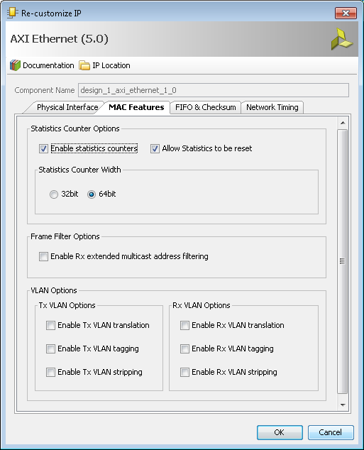
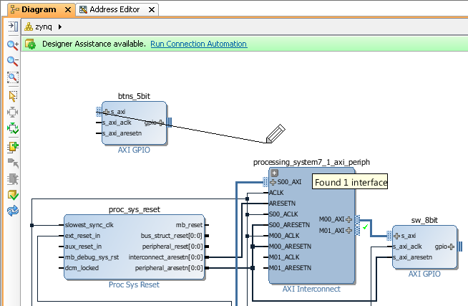
Configuring Hardware in IP Integrator
Double click blocks to access configuration options
Drag pointer to make connections
Highlights valid connections
Connection Automation
Automatically connect recognised interfaces
Automatically Redraw system

Slide 16
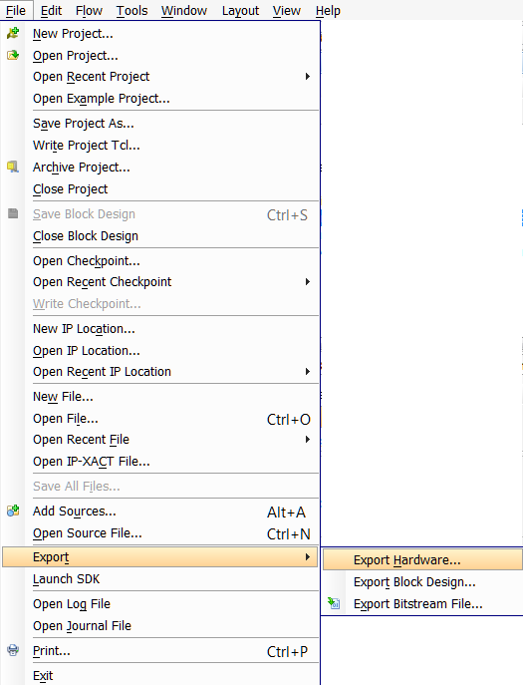
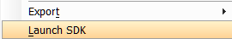
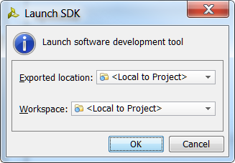
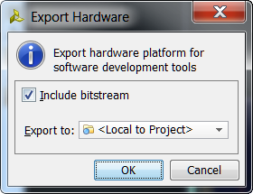
Exporting to SDK
Export hardware first
The Hardware Description File (hdf) format file containing all the relevant information will be created and placed under the *.sdk directory
Include bitstream if generated
Launch SDK
Software development is performed with the Xilinx Software Development Kit tool (SDK)
The SDK tool will then associate user software projects to hardware

Slide 17
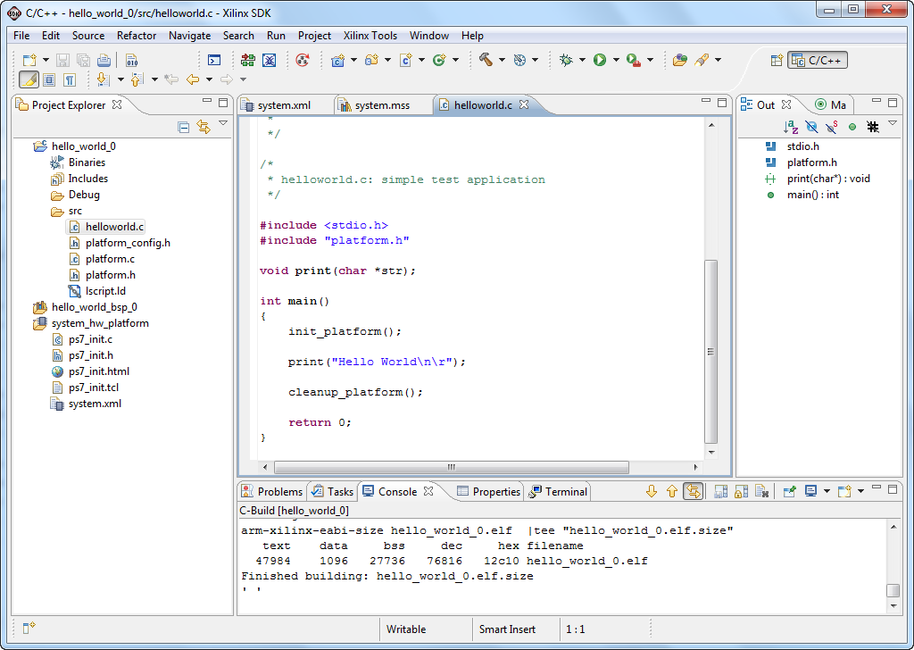
Software Development Flow
Create hardware platform project
Automatically performed when SDK tool is launched from Vivado project
Create BSP
System software, board support package
Create software application
Create linker script
Build project
compile, assemble, link output file <app_project>.elf

Slide 18
References
Zynq ebook Chapter 1.

